Slide 1

Design Project Presentation
M. Chaves, G. Iven, A. Rasoulof
Spring 2013

Slide 2
Outline
General design scheme
Circuit design
Circuit output

Slide 3
General design scheme
Input stage
Gain stage
Output stage

Slide 4
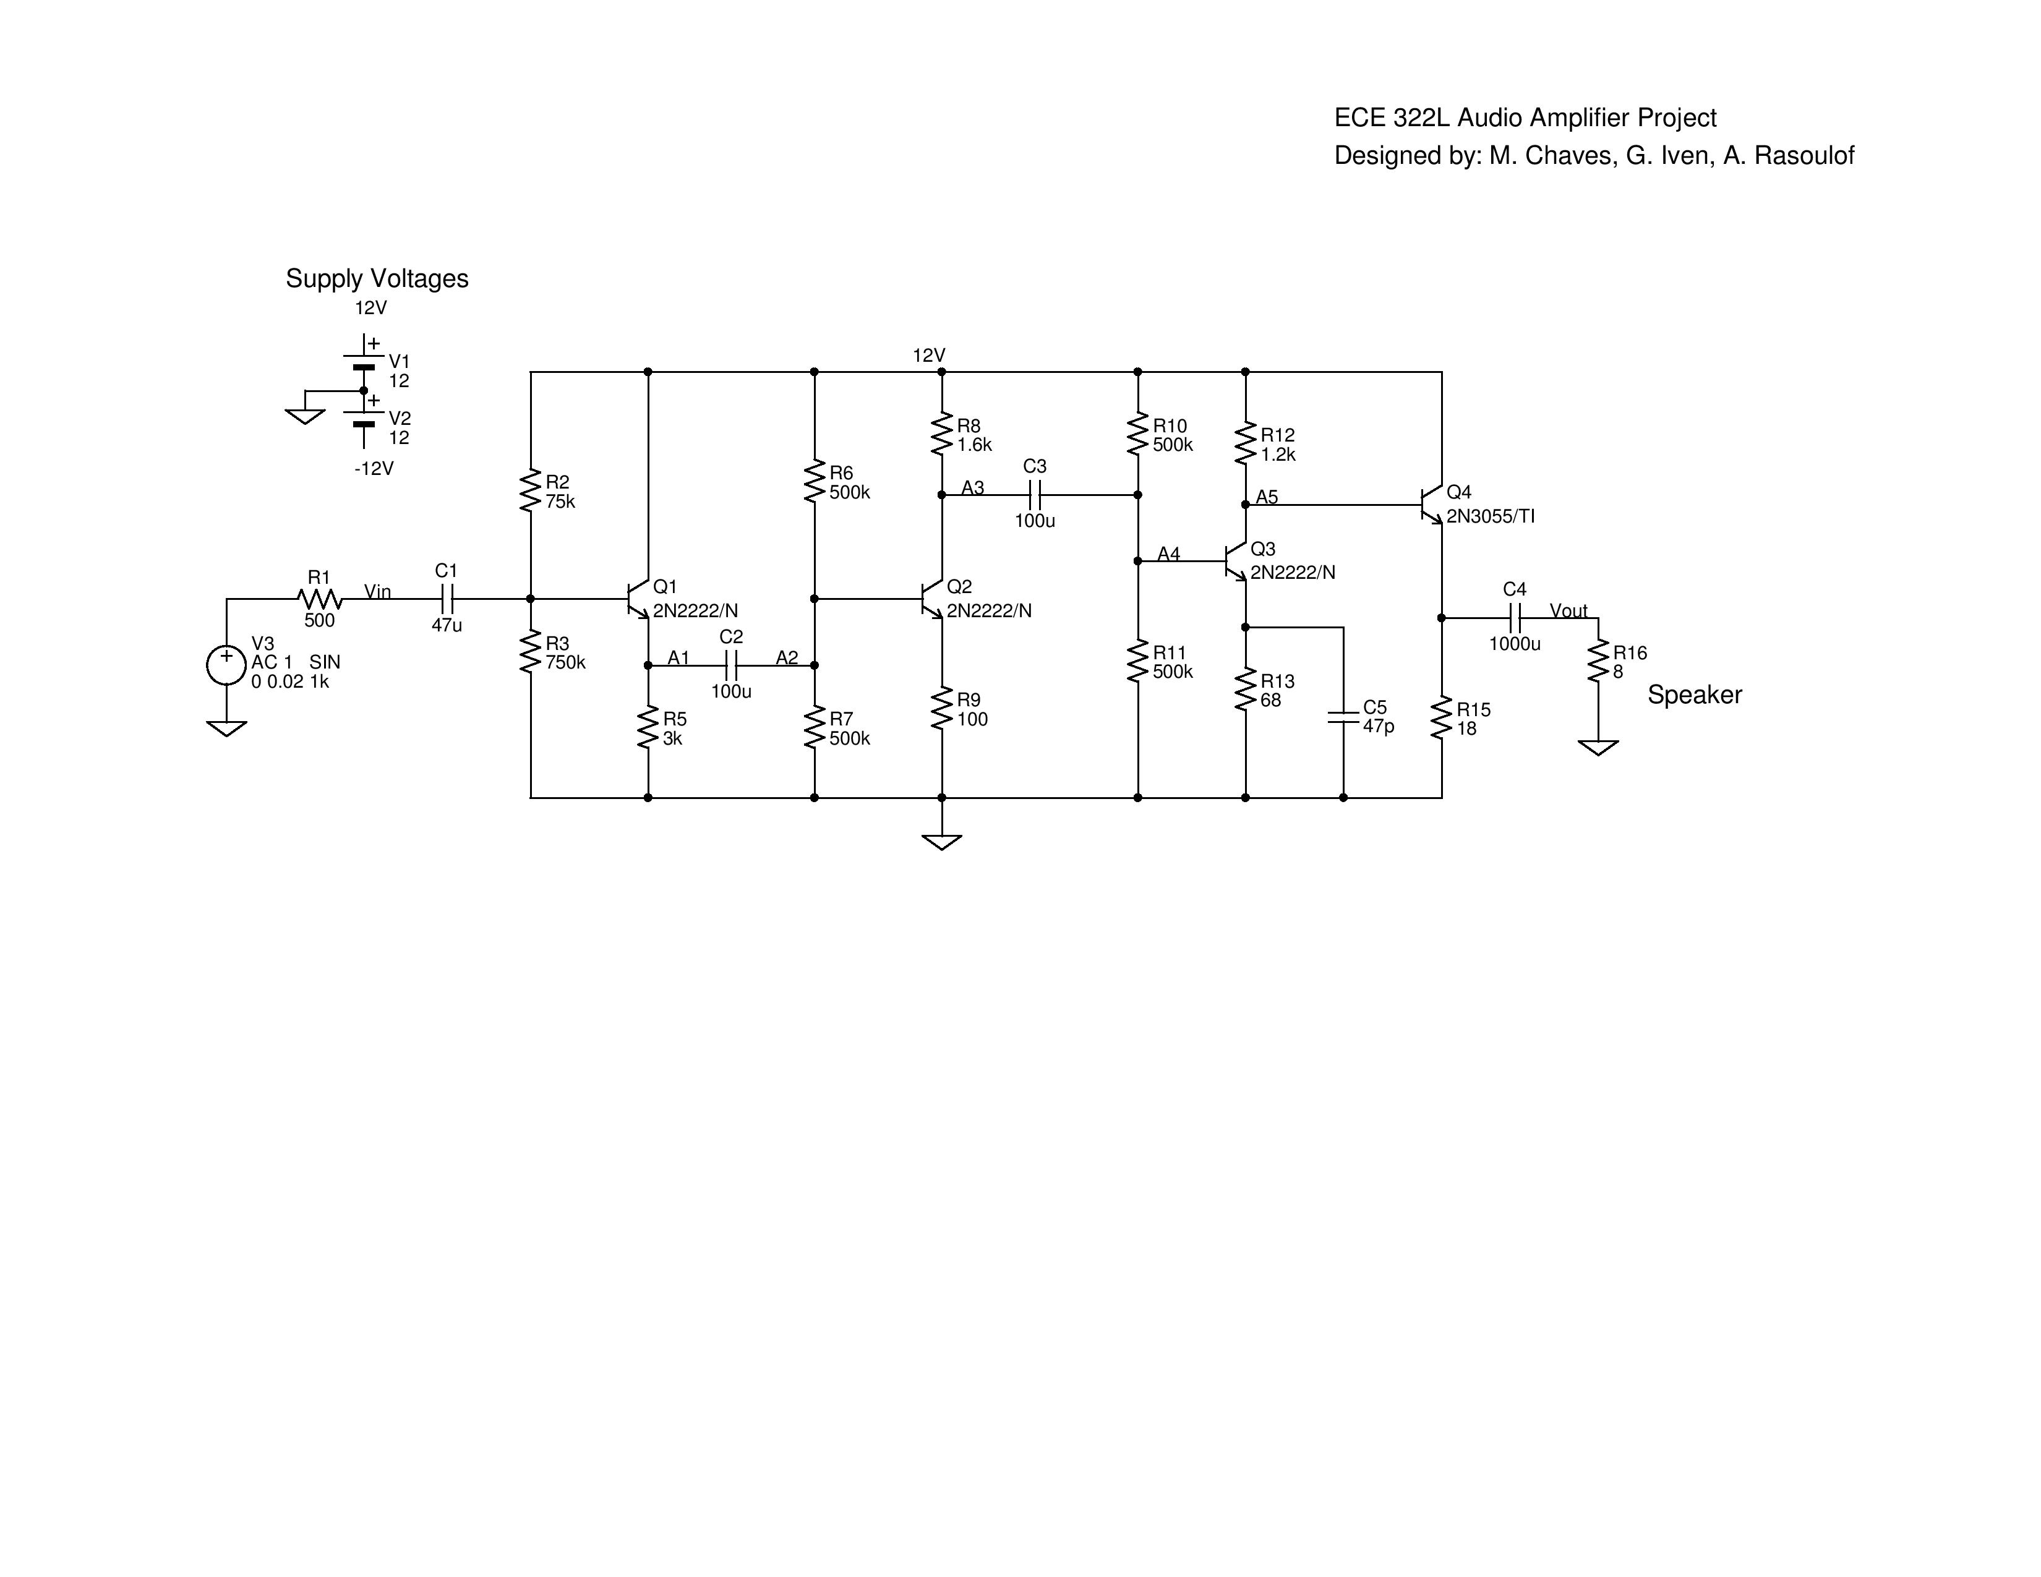
Circuit design
Input stage
2 Gain stages
Output stage

Slide 5
Simulation outputs
Q1 Q4 Q2 Q3
MODEL 2N2222/N 2N3055/TI 2N2222/N 2N2222/N
IB 1.7904E-05 2.6118E-03 1.9899E-05 2.0342E-05
IC 2.9900E-03 2.1840E-01 3.4868E-03 3.4968E-03
IE -3.0079E-03 -2.2101E-01 -3.5067E-03 -3.5172E-03
IS 0.0000E+00 0.0000E+00 0.0000E+00 0.0000E+00
VBE 0.6737 0.6997 0.6767 0.6774
VBC -2.3107 -7.3258 -5.3963 -3.7577
VCE 2.9844 8.0255 6.0731 4.4351
VCS 12.0000 12.0000 6.4236 4.6742
BETADC 166.9976 83.6193 175.2246 171.9051
GM 1.1441E-01 8.0755E+00 1.3326E-01 1.3361E-01
RPI 1.5783E+03 1.1159E+01 1.4178E+03 1.3865E+03
RX 1.0000E+01 1.0000E+01 1.0000E+01 1.0000E+01
RMU 6.0544E+12 2.6028E+12 6.0758E+12 6.0688E+12
RO 2.5531E+04 2.6248E+02 2.2778E+04 2.2244E+04
CPI 8.4217E-11 3.1700E-07 9.2053E-11 9.2215E-11
CMU 4.5204E-12 1.2499E-10 3.5619E-12 3.9602E-12
CBX 0.0000E+00 0.0000E+00 0.0000E+00 0.0000E+00
CCS 0.0000E+00 0.0000E+00 0.0000E+00 0.0000E+00
BETAAC 1.8057E+02 9.0118E+01 1.8894E+02 1.8525E+02
FT 2.0520E+08 4.0528E+06 2.2182E+08 2.2110E+08

Slide 6
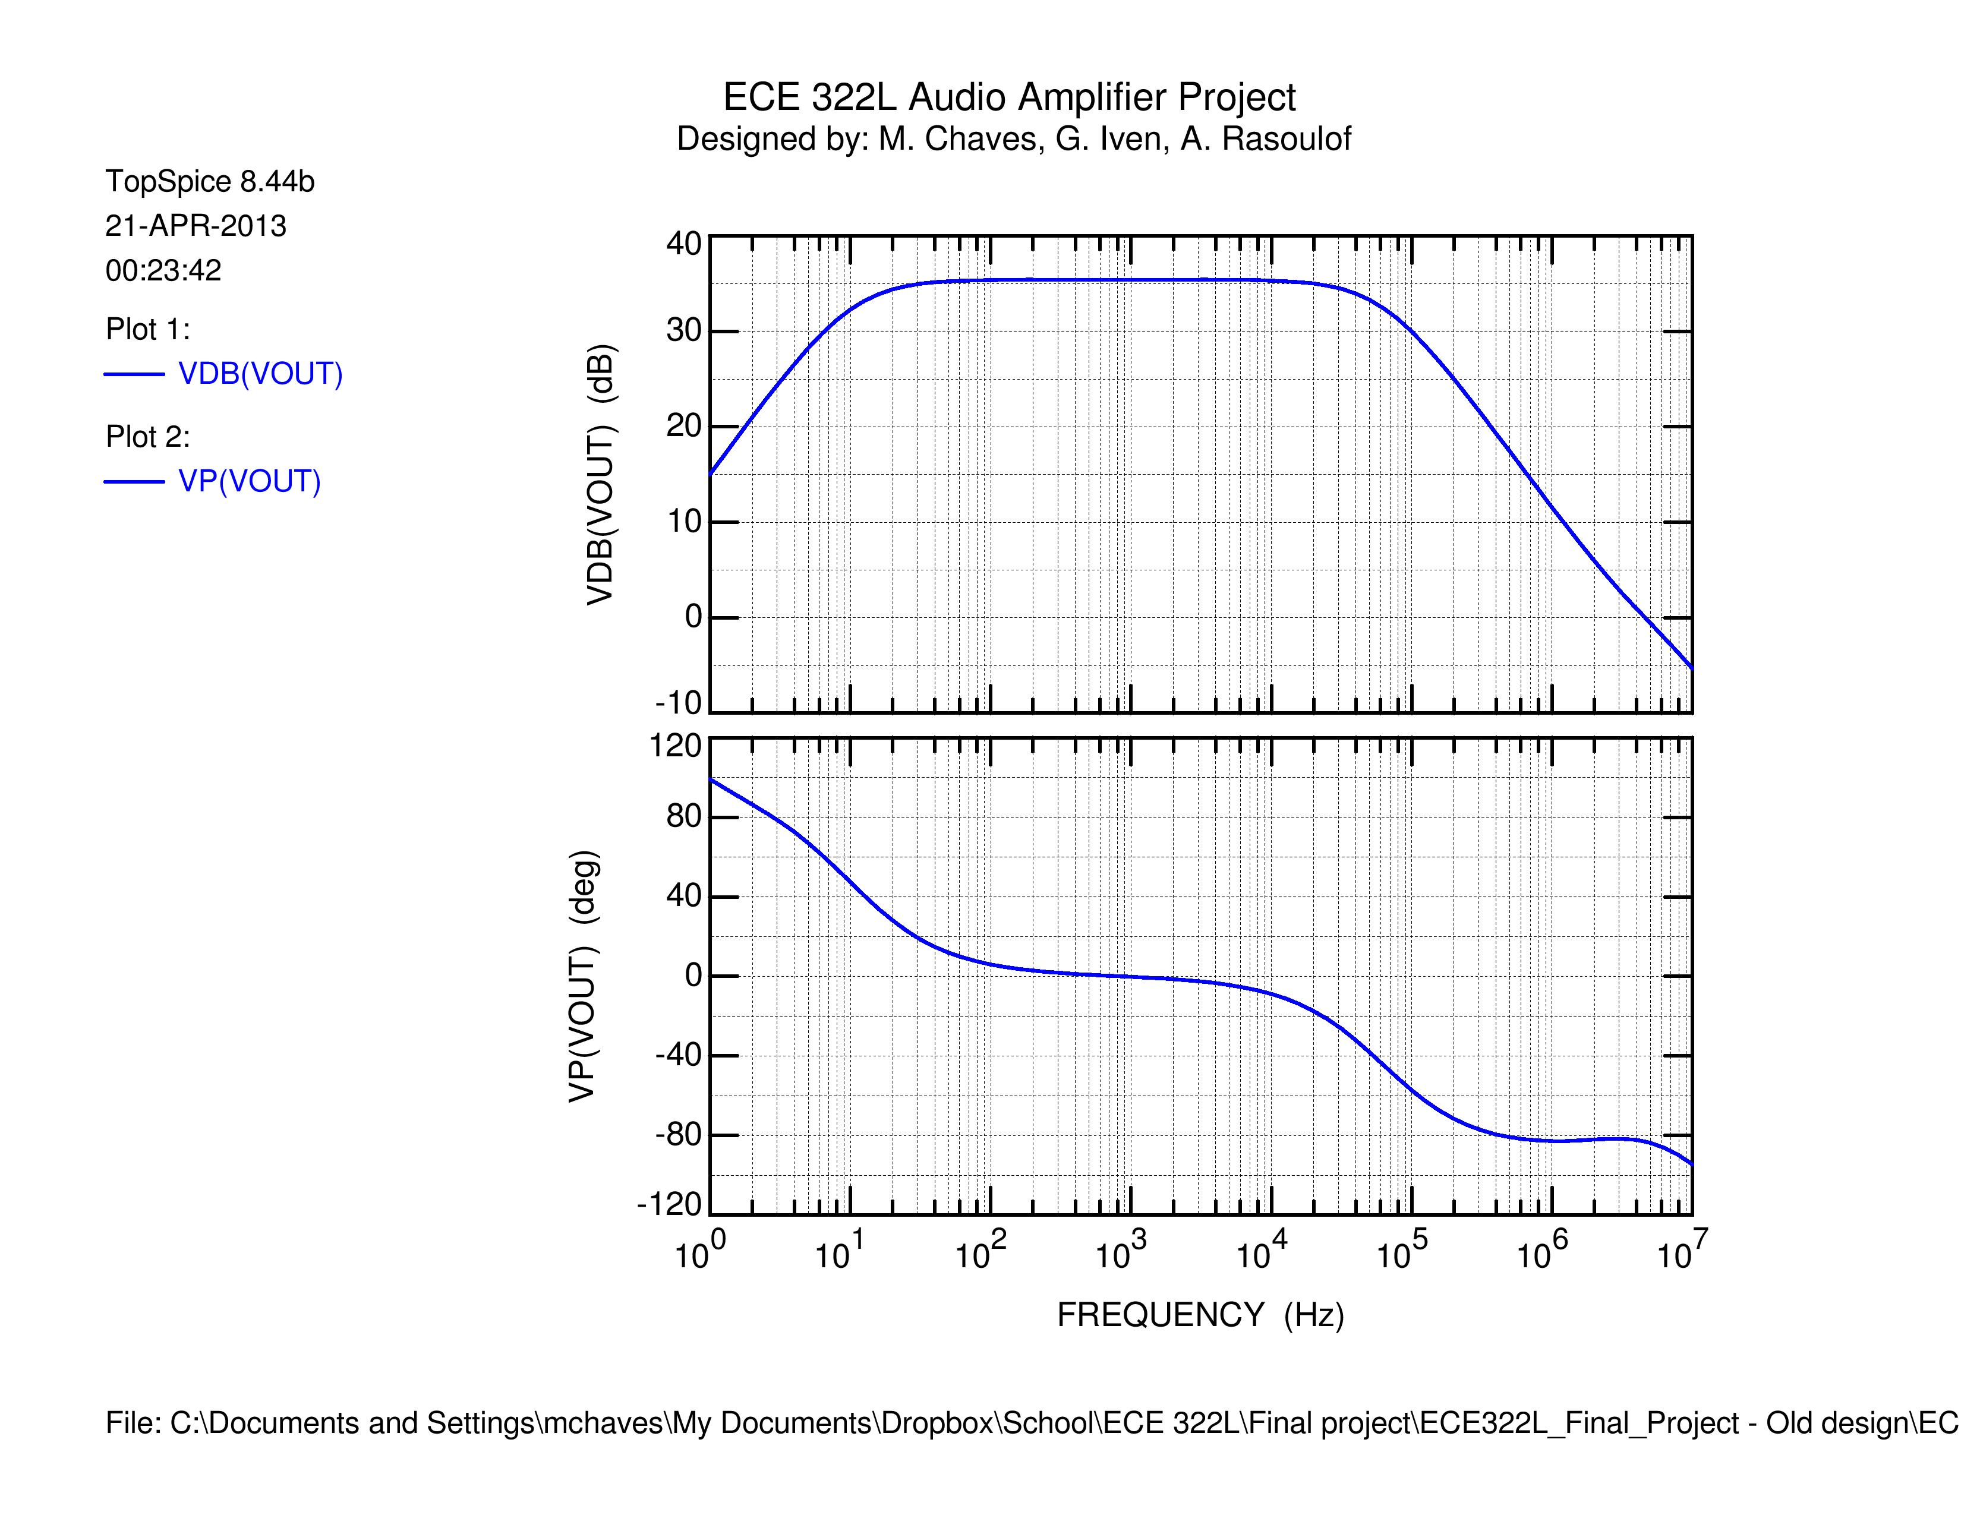
Amplifier frequency response

Slide 7
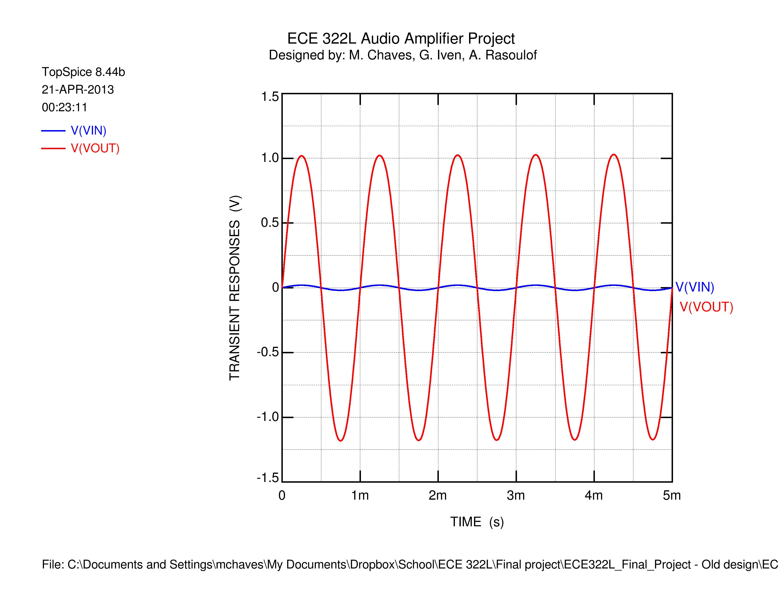
Amplifier single frequency response

Slide 8
Design issues
Part tolerances
Bad parts

Slide 9
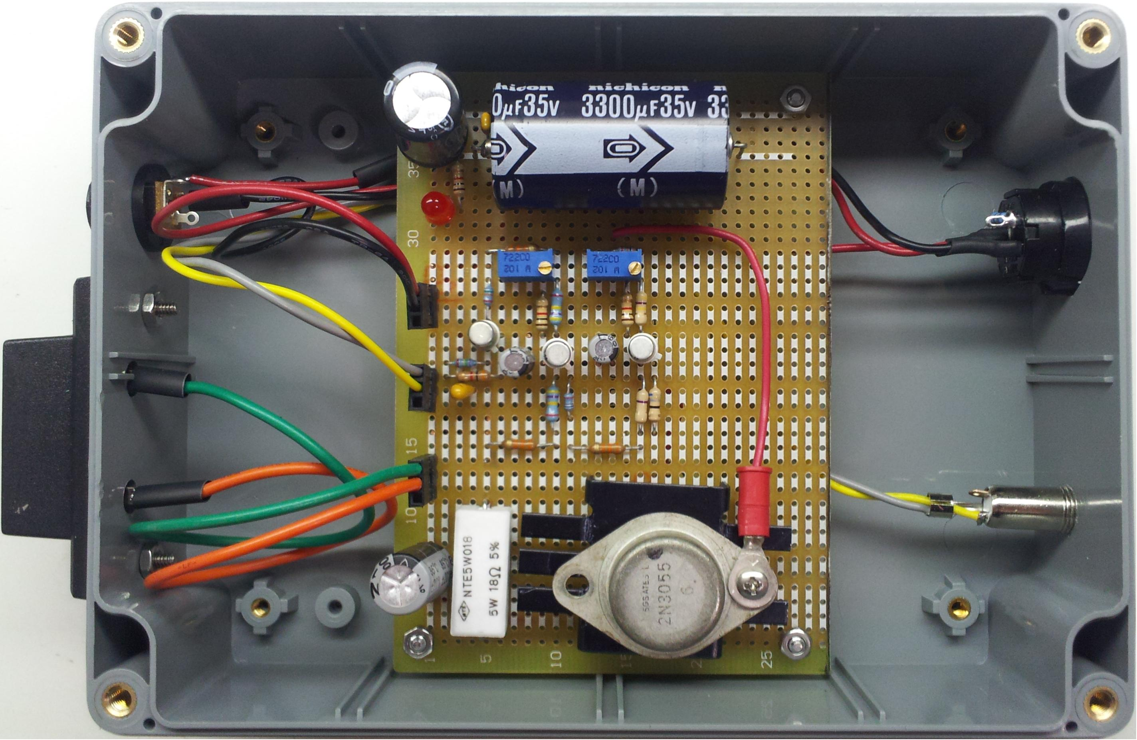
Final Product

Slide 10
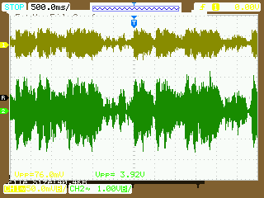
Music waveforms captured on the input and output of our circuit

